Slide 1



Progetto HCI
Mathias Dalla Palma
VR504159

Slide 2



A workflow for 3D scanning to VR
Photogrammetry model reconstruction using Zephyr
Unity scene integration and AR elements
Fiore Method
In this presentation
Feature Matching
Feature Matching and Camera Pose Estimation
LoFTR
Implementation and results
VR Interaction and Application
Interactive exploration and movement system
Photo Matching Challenge

Slide 3

Workflow: From 3D Scanning to VR
Image Acquisition
3D Reconstruction
Unity Integration
Camera Pose Estimation

Slide 4
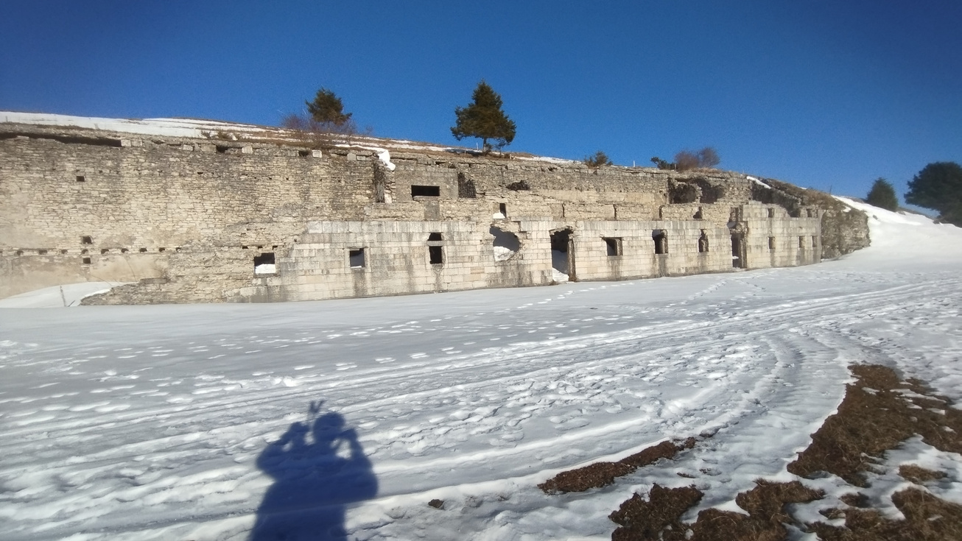

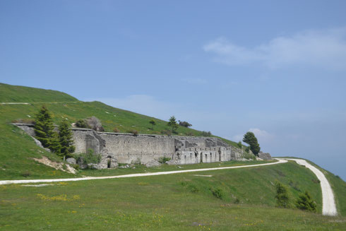
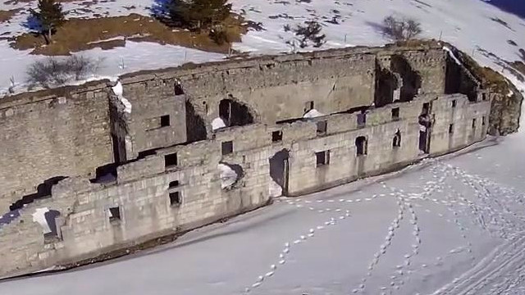
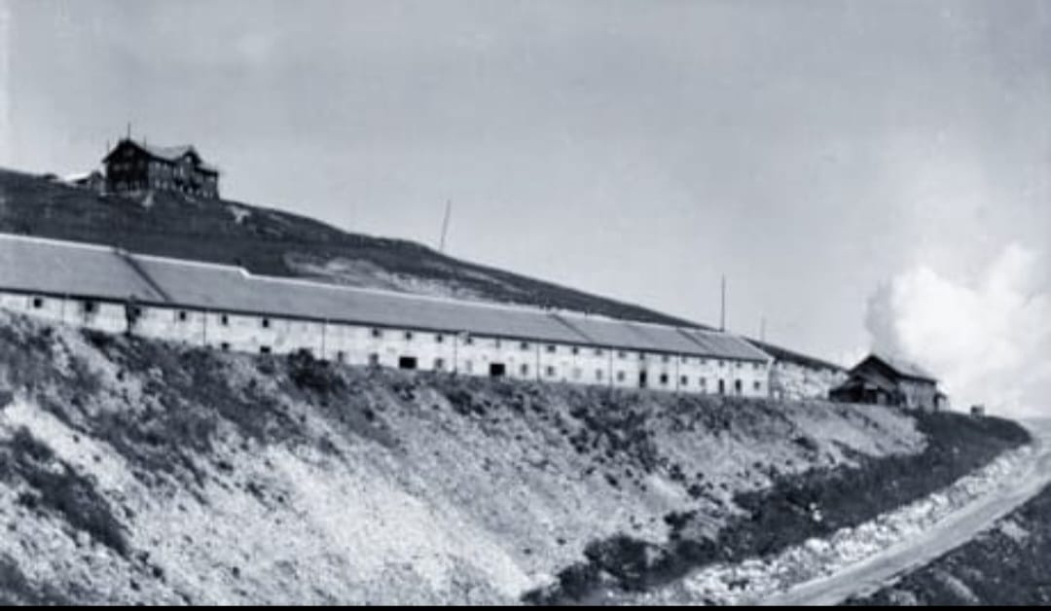
1. Image Acquisition
Technical Informations:
80 Images
Nikon Coolpix L83
3264×1836 pixel
Subject:
Forte Lisser Barracks
Drone photage

Slide 5
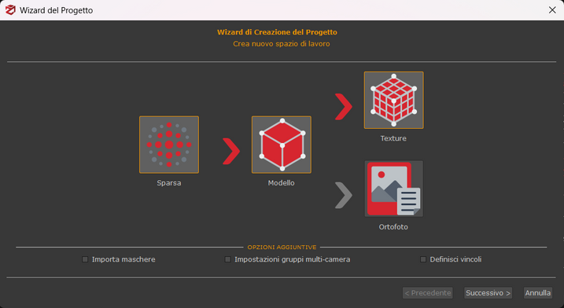

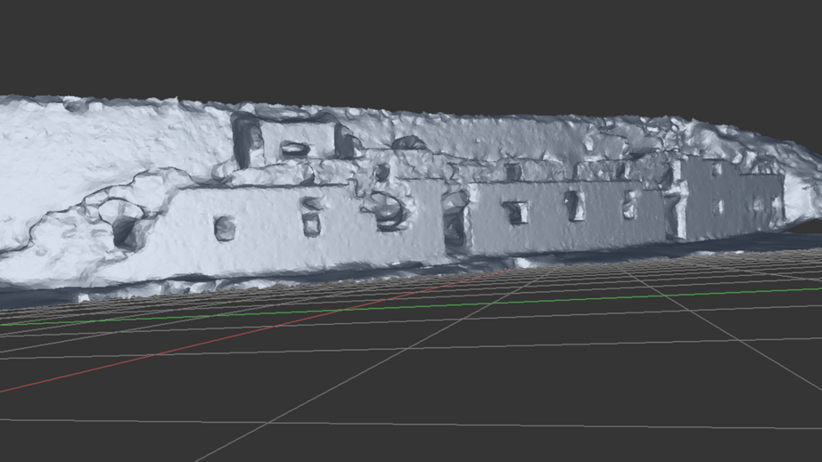
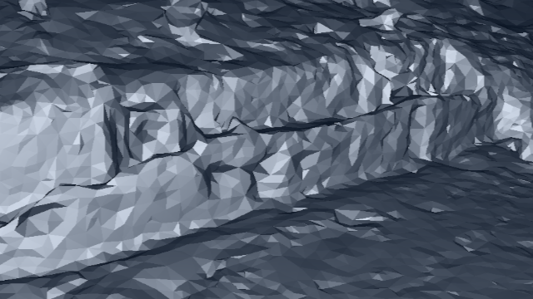
2. 3D Reconstruction
Results:
Output:
3D model with textures (obj)
Dense cloud point (ply)
Extrinsic parameters for each image (xmp)
Visibility file (txt)

Slide 6
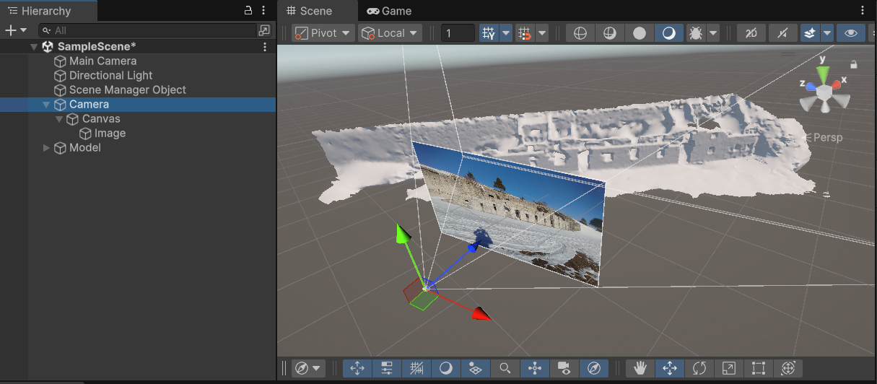
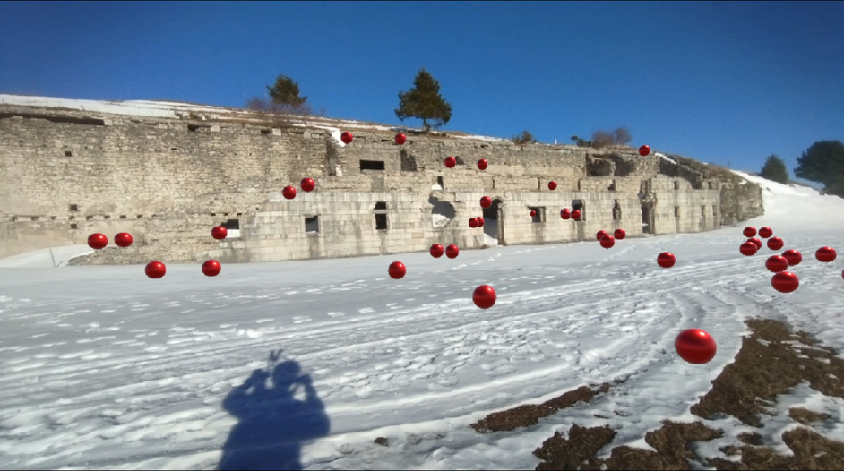
3. Unity Integration
Place the model
Parse information from XMP file
Apply conversion from rotational matrix to euler angles
C# Script

Slide 7
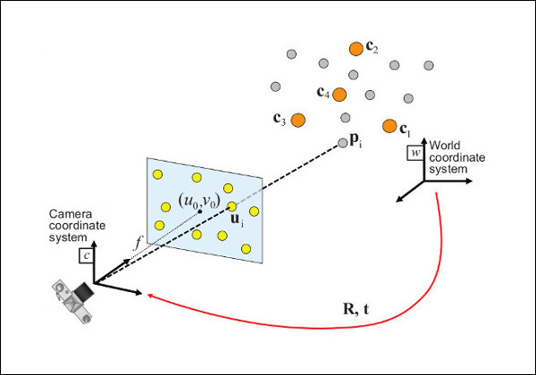
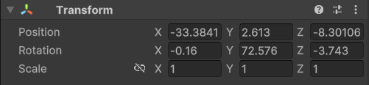
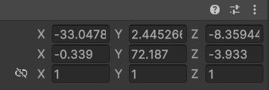
4. Camera Pose Estimation
Objective
Calculate from scratch the extrinsic parameter of an image starting from a given 2D-3D corrispondece
Fiore Method
Implementation
Input:
Visibility file
Dense Cloud Points
Output:
Extrinsic parameters
Result
ground truth:
calculated:

Slide 8
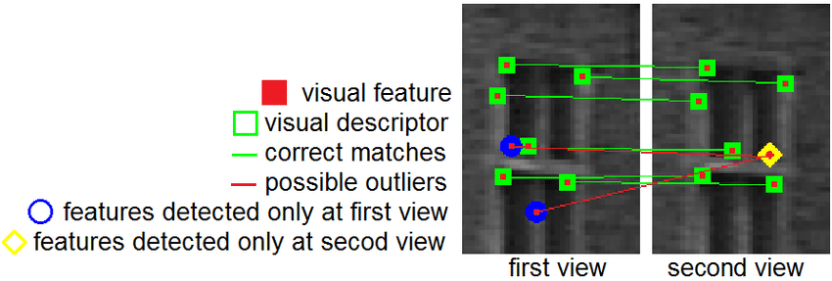
Feature Matching
Dense clout point
(.ply file)
Reference image
Visibility file
Target image

Slide 9
Feature Matching
Dense clout point
(.ply file)
Reference image
Visibility file
Target image

Slide 10
Feature Matching
Dense clout point
(.ply file)
Reference image
Visibility file
Target image

Slide 11
Feature Matching
Dense clout point
(.ply file)
Reference image
Target image
Result:
2D-3D correspondences betwen pixels of the target image and points of the 3D model

Slide 12
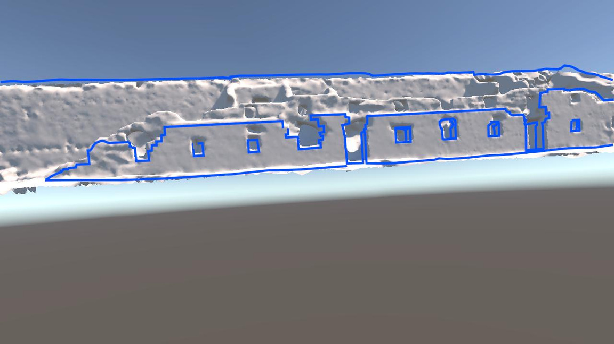
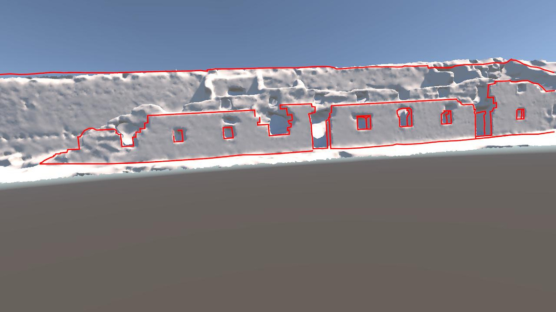
Results of feature matching
Calculated
Ground Truth
Errors for this example: 2.54 in translation (~ 70cm), 6.03 in rotation (~ 5° in pitch, 0.4° in roll, and 0.1° in yaw)

Slide 13
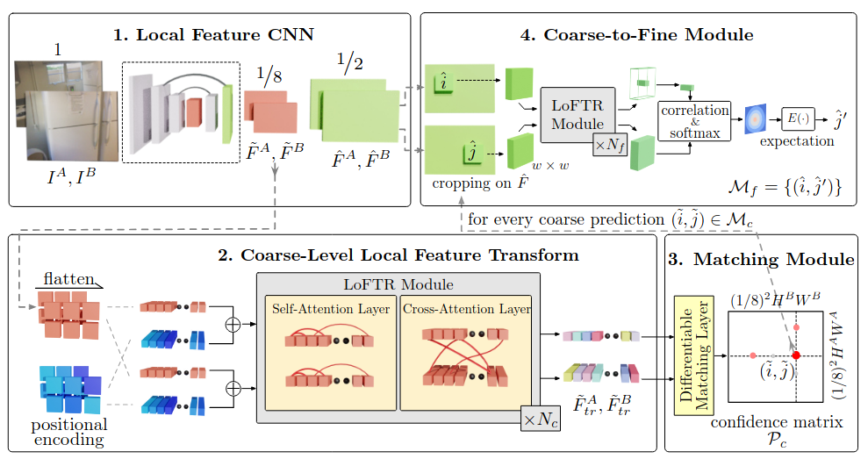
LoFTR

Slide 14
Use of LoFTR
Dense clout point
(.ply file)
Reference image
Visibility file
Target image

Slide 15
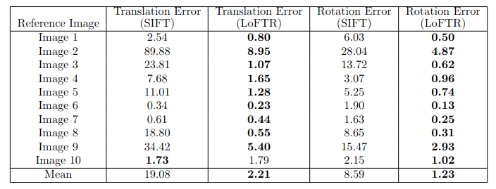
SIFT vs LoFTR

Slide 16
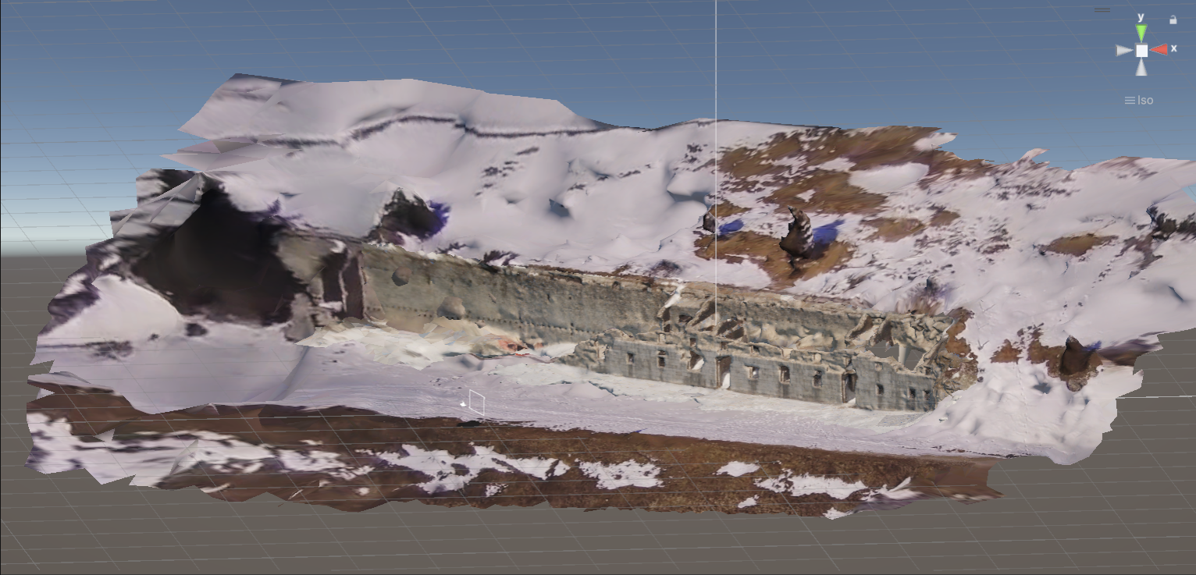
VR Interaction and Application

Slide 17
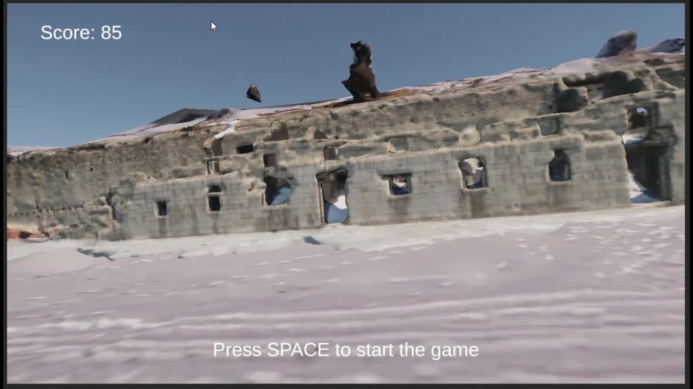
VR Interaction and Application
Photo matching challenge

